Slide 2
objectives

Slide 3
Methodology

Slide 4


Thresholding

Slide 5

Thresholding

Slide 6
Parametric

Slide 7
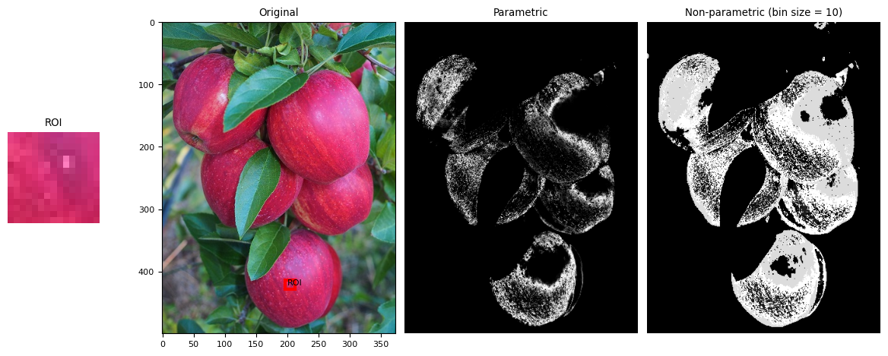
Non-Parametric

Slide 8


Slide 9



Slide 10
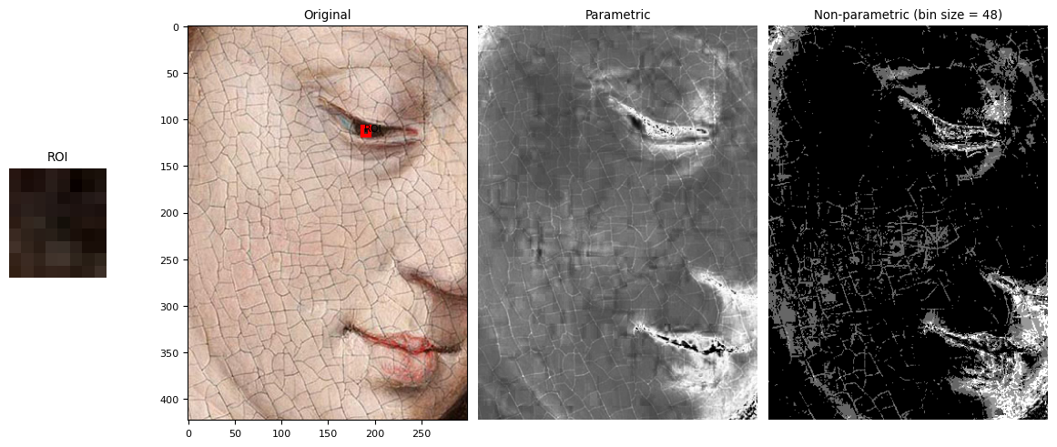

Art Applications

Slide 11

In motion

